Slide 1
Micro Services

Slide 2

Monolithic Application
A traditional way of building software
Built as a single unit that includes all of the different components of the application, including APIs, services, databases, load balancers etc.,
Designed to be self-contained
All the components must be present in order to deploy or compile the application.

Slide 3
4 Key Components
Client-side user interface: The user interface is the part of the application that allows users to communicate and interact with the app.
Business logic: Stands between the user interface and the database. It represents the real-world business rules that ultimately decide how the app processes data.
Data access layer: This layer comes between the business logic and the database, This layer provides different methods to access the data stored in the underlying database.
Database: Monolithic applications typically have a single database that stores all the information that the application needs in order to function.

Slide 4
CaCHALLENGES OF MONOLITHIC cha Challenges with Monolithic Application
As application is too large and complex,it becomes difficult to manage
One single unit, so you must redeploy the entire application on each update
Difficult to adopt new technology for single functionality
Single bug may slow down the entire application

Slide 5
Microservices
. Microservice is a small unit that has only one responsibility or single logic which solve a specific problem.
Microservices are the evolution of service-oriented architecture.
Microservices are small and independent services that work together
Each Microservice can be deployed independently.
A Microservice itself persist its own data or external state.
All services don't need to share the same technology stack, libraries, or frameworks.

Slide 6
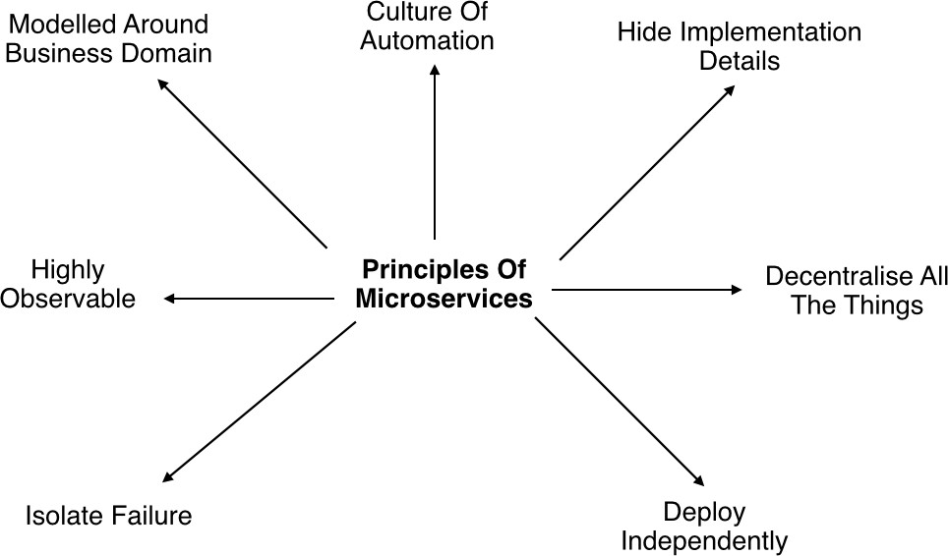
Microservices Principles

Slide 7
Microservices Principles (Contd…)
Modelled around business domain : Separate system capability into different domains and each domain will focus on one thing and its associated logic.
Culture of Automation : Follow the culture of automation by designing it for continues integration and continuous delivery.
Hide implementation details : This reduce the coupling and helps to do changes and improvement without affecting the overall architecture.
Decentralization : There is no centralized database, usually each service is designed to manage its own database.

Slide 8
Microservices Principles (Contd…)
Deploy Independently : Each service can be deployed independently.
Failure Isolation : The impact of a failure is less in microservice architecture compares to monolithic type as it will only affect that particular service and its associates. Other services can keep running.
Highly Observable : The services should collect as much information to analyze what is happening within each of them like log events and stats

Slide 9
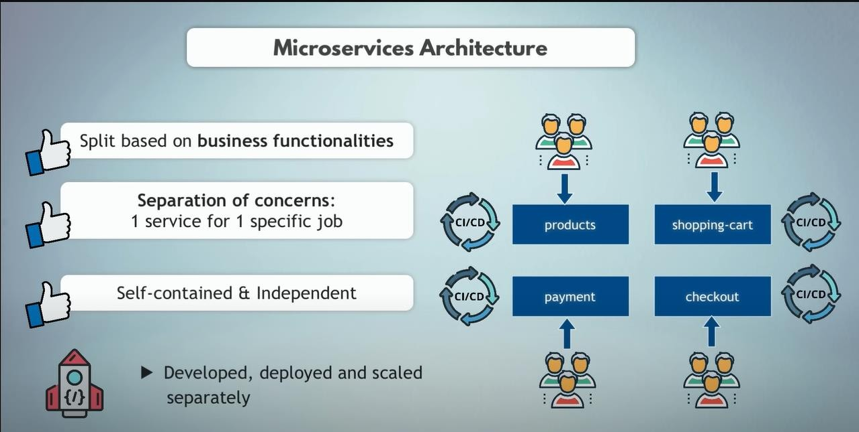

Slide 10
ADVANTAGES OF MICROSERVICES
It is possible to change or upgrade each service individually rather than upgrading in the entire application
One service may down without impacting to others
Easily use different technology for building different microservices
Less dependency loosely coupled

Slide 11
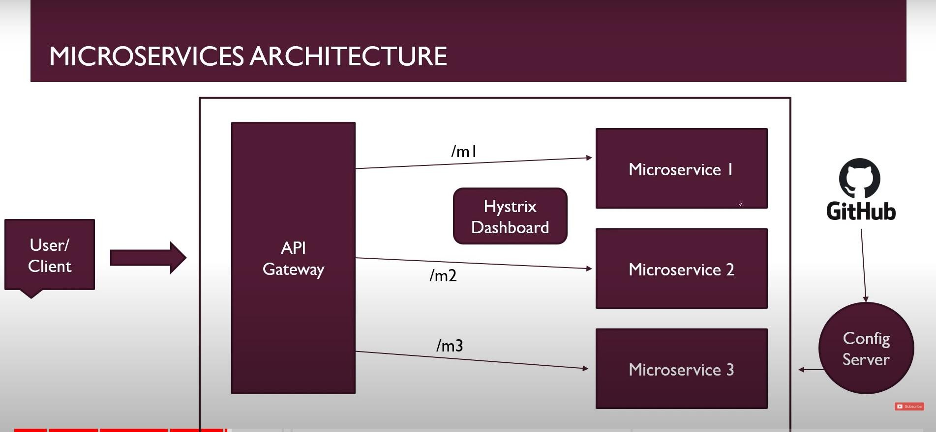

Slide 12
COMMUNICATIONS BETWEEN MICROSERVICES
Communication via API calls
Communication via Message Broker

Slide 13
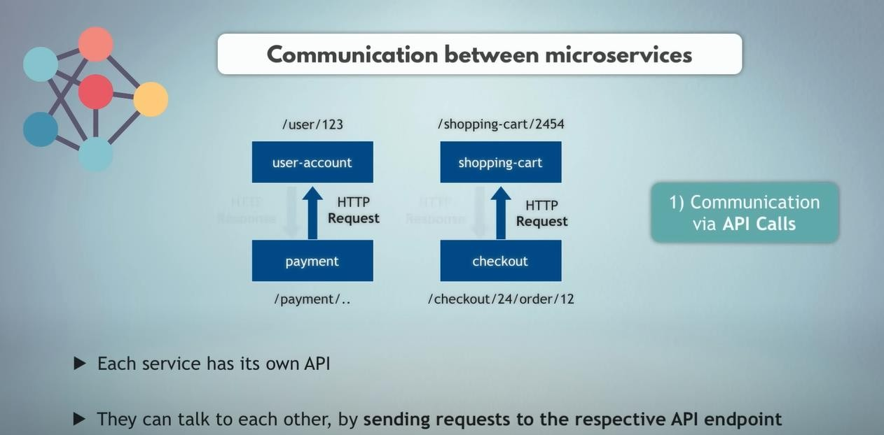

Slide 14
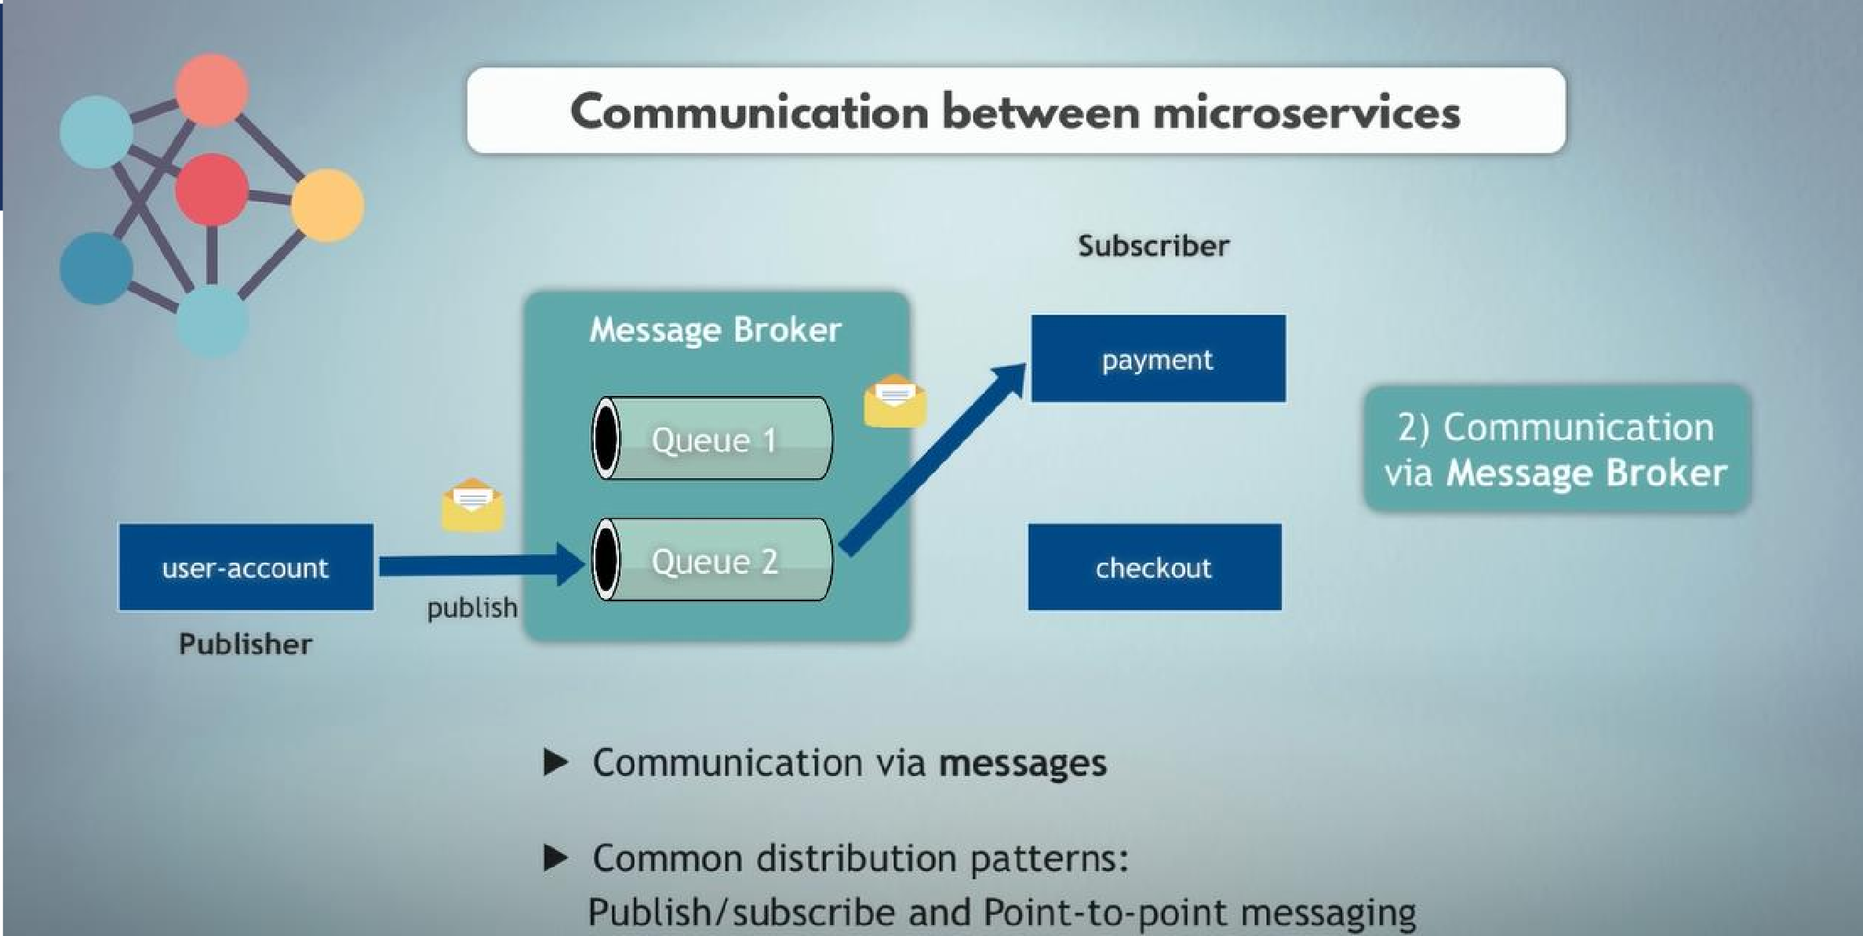

Slide 15
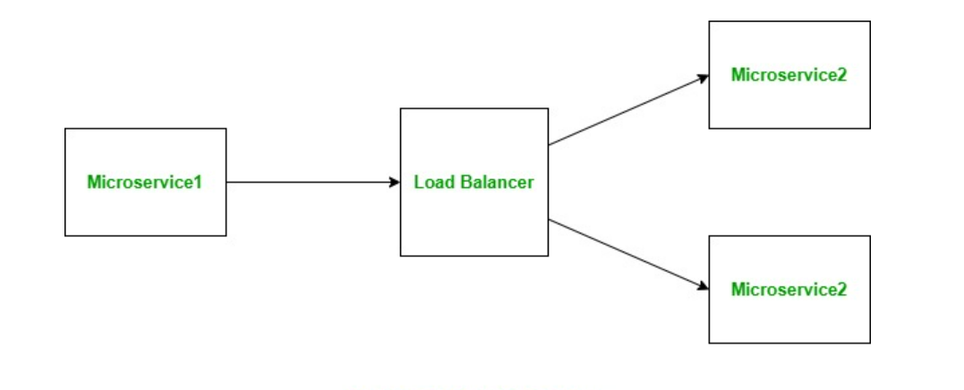
Load Balancing
Refers to efficiently distributing the incoming network traffic across a group of backend servers.
Load balancing can be of two types:
Server-side Load Balancing
Client-side Load Balancing
Server-side Load Balancing

Slide 16
Disadvantages of Server-side load balancing
Acts as a single point of failure as if it fails, all the instances of the microservice becomes inaccessible as only load balancer has the list of servers.
Since each microservice will have a separate load balancer, the overall complexity of the system increases and it becomes hard to manage.
The network latency increases as the number of hops for the request increases from one to two with the load balancer, one to the load balancer and then another from load balancer to the microservice.

Slide 17
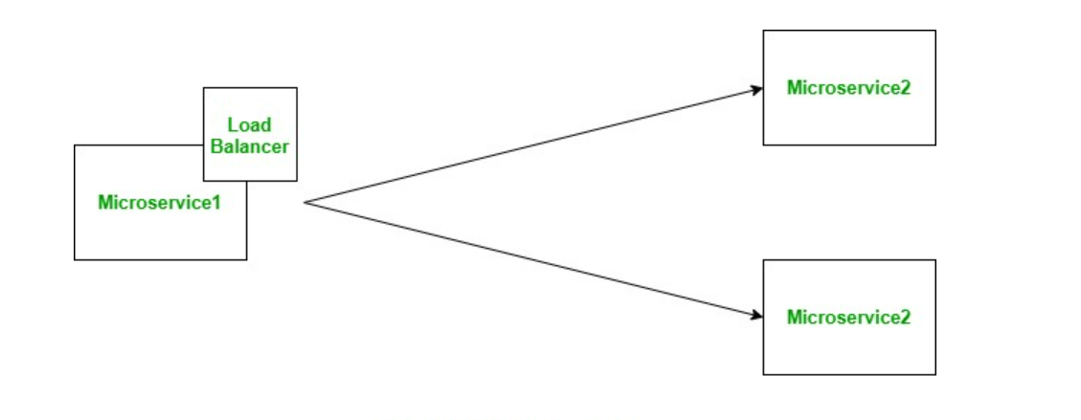
Client-side Load Balancing

Slide 18
Netflix's Ribbon
Is an Inter Process Communication (remote procedure calls) library with built in client side(software) load balancer and is a part of Netflix Open Source Software (Netflix OSS).
Features of Ribbon:
Load balancing: It provides client side load balancing functionality.
Fault tolerance: It can be used to determine whether the servers are up or not and can also detect those servers that are down and hence, ignore them for sending the further requests.
Configurable load balancing rules: By default ribbon uses RoundRobinRule for distributing requests among servers. In addition to it, it also provides AvailabilityFilteringRule and WeightedResponseTimeRule.
It supports multiple protocols like HTTP, TCP, UDP etc.

Slide 19
Circuit breaker
A Design pattern, used extensively in distributed systems to prevent cascading failures.
Usually implemented as an interceptor pattern/chain of responsibility/filter. It consists of 3 states:
Closed: All requests are allowed to pass to the upstream service and the interceptor passes on the response of the upstream service to the caller.
Open: No requests are allowed to pass to upstream and interceptor responses with a default response generally an error response.

Slide 20
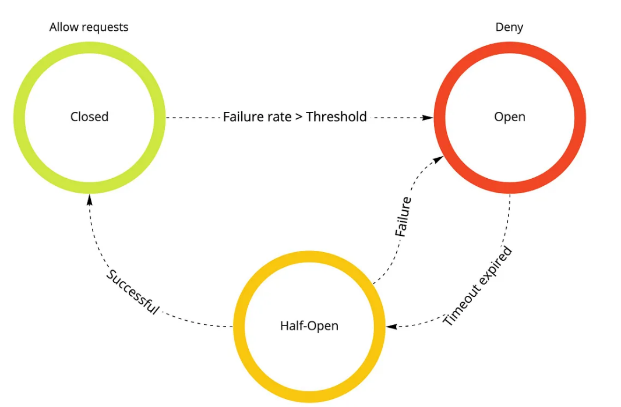
Circuit breaker (Contd…)
Half-Open: Some of the requests are allowed to pass to upstream others are terminated and responded with a default response.

Slide 21


